Slide 1


Sustainability Grants Search & Grant Writing
October 5, 2023
Prepared by:

Slide 2
Agenda
2
Introductions
About Andrew Chang & Company
Overview of services and approach
Organization chart
Resources and budget

Slide 3
Andrew Chang & Company provides end-to-end consulting services across multiples industries and policy areas
3
Andrew Chang & Company, Inc. Experience Matrix
Key Observations
20 years of professional experience in both the public and private sectors working with both high-level executives and operations staff on sensitive issues under tight deadlines. A diverse set of clients including government agencies. non-profit organizations and Fortune 1000 companies
Hands-on consulting experience:
Public Policy & Business Strategy:
  Competitor intelligence
  Policy development & implementation
  Business strategy development
  Economic & Financial Analysis
  Economic and market assessments
  Public finance analysis & strategies
  Management and operations:
  Supply chain re-engineering
  Resource assessments
  Business process re-engineering
  Performance benchmarking
  Change management
Information technology:
Systems process mapping
Requirements development
Project management
Health &
Human Services
Military &
Aerospace
Education
Business &
Infrastructure
General
Government
Energy &
Natural Resources
Public Policy &
Business Strategy
Development
Economic &
Financial
Analysis
Program Design &
Operations
Consulting
Information
Technology
Consulting
Primary Experience
Secondary Experience

Slide 4
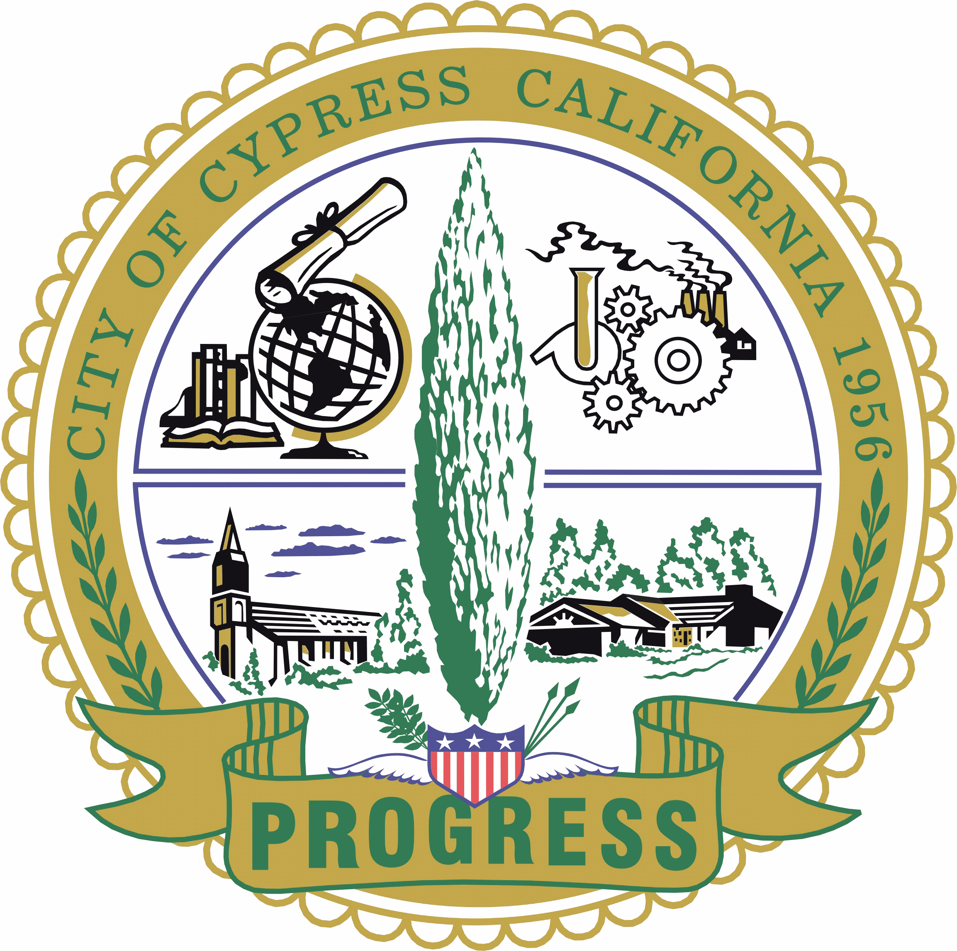




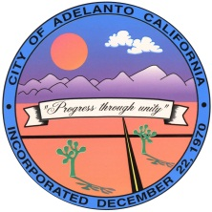
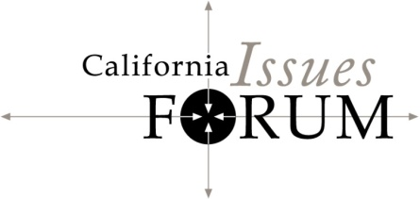









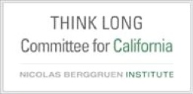









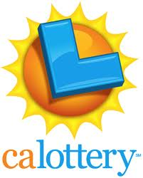

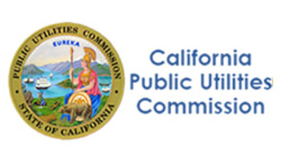
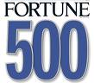

Our clients are from government, non-profits and the private sectors
4
PARTIAL LIST

Slide 5
We have extensive experience in both public and private sector procurement and contracting best practices
5
Former Chief Deputy of the California Department of General Services;
Current member of DGS Small Business Council’s Procurement Policies and Procedures Committee
State retained Subject Matter Expert
Conduct contract and grant procurements for a number of state agencies, both within and outside of Public Contract Code (over $500 million over the past ten years)
Re-engineered procurement processes and trained staff for public organizations, including the California Public Utilities Commission, Department of Toxic Substances Control, Department of Community Services and Development
Public Sector
Private Sector
Strategic sourcing of numerous commodity categories
Negotiated acquisitions of numerous non-commodity items
On a limited basis, retained to support private sector clients pursue government grants (75% success rate over the past 5 years)

Slide 6
Grants leads can be generated both passively and actively
6
Passive Monitoring
Monitoring of legislation and budget proposals
Weekly monitoring of grant posting web sites and available publications
Develop “canned” marketing materials
Identify likely opportunities and create lead target list
Arrange meetings with appropriate funding programs to seek opportunities for mutual benefit and streamlined contracting, including use of Interagency Agreements with state agencies
Active Lead Development

Slide 7
We propose to support CSU over the term of the contract
7
F O R D I S C U S S I O N
Phase I
Project Kickoff
Phase II
Landscape Survey
& Data Gathering
Phase III
Opportunity Monitoring
& Identification
Phase IV
Proposal &
Active Marketing Support
Time:
Day 1
Day 1 - 30
Ongoing
Typically 30 – 45 days
Goals:
Introduce working staff
Establish common understanding of scope and operations protocols
Establish understanding of campus’ key personnel, opportunity preferences, experiences and resources
Refine passive monitoring lists
Identify Interagency Agreement opportunities
Passively monitor identified lists and opportunities
Generate leads on active marketing
Respond to RFAs, as appropriate
Develop presentation decks for active marketing and support contracting, as appropriate
Key
Activities:
Develop kick-off material
Conduct kick-off meeting with key personnel (CSU Chancellor’s Office and select campuses, as appropriate)
Establish grant response teams
Develop opportunity preference profile
Refine draft opportunities list
Gather relevant proposals and information
Develop documents library of common response requirements
Passively monitor identified lists and opportunities
Generate leads for active marketing
Kickoff with opportunity team
Establish schedules
Gather required documents
Support drafting of responses
Develop marketing materials, schedule and support active marketing efforts
Support contract development, as appropriate
Deliverables:
Kickoff materials
Kickoff meeting
Key contacts lists
Documents library of draft common response requirements
Weekly monitoring reports
Monthly summary of potential active marketing leads
Project kickoff materials and meetings
Draft proposals
Marketing materials
Draft contract scope of work and budget

Slide 8
We work with our clients to improve grant response capacity
8
Assemble and Develop Common Background Material
Collect and develop common response elements in advance of issuance of grant opportunities, including organizational background, personnel profiles and key resumes, case studies, references and common forms
Internal
Conduct process improvement debriefing after each procurement with internal team
External
Review procurement assessment files, as available
Request oral and/or written feedback from private funders
Actively Seek Feedback

Slide 9
Our project team is divided into opportunity identification and grant writing activities
9
F O R D I S C U S S I O N
CSU
Contract Manager
Andrew Chang
Project Contract Manager
Lead Generation
Grant Writing
Andrew Choi, Business Analyst
Timothy Park, Business Analyst
Harris Razaqi, Business Analyst
Robert Domenech, Business Analyst

Slide 10
Contact information
10
Andrew Chang & Company, Inc.
1107 9th Street #360
Sacramento, CA 95814
916-538-6091
www.AChangLLC.com
Andrew Chang
Managing Director
andrew.chang@achangllc.com
Office: 916-538-6091, Ext. 1
Mobile: 415-572-5291
Andrew Choi
Business Analyst
andrew.choi@achangllc.com
Office: 916-538-6091, Ext. 5
Timothy Park
Business Analyst
timothy..park@achangllc.com
Office: 916-538-6091, Ext. 4
Robert Domenech III
Business Analyst
robert.domenech@achangllc.com
Office: 916-538-6091, Ext. 2
Harris Razaqi
Business Analyst
harris.razaqi@achangllc.com
Office: 916-538-6091, Ext. 3

Slide 11
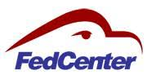




Section 5.A - Preliminary List of Federal Funding Sources to Monitor
Grant Source | Description (Why it is relevant to this RFP) | URL
 | FedCenter stores grants ranging from various Federal, State, and non-profit organization grant opportunities, including but are not limited to: Air, Cleanup, Climate Adaptation, Energy, Environmental Justice, Sustainability, Water, etc. | https://www.fedcenter.gov/opportunities/grants/
 | Grants.gov is one of the largest databases storing grants and grantors in the US. | https://www.grants.gov/
 | The National Science Foundation provides grants to support scientific research and education initiatives related to sustainability and energy, with the aim of advancing knowledge and understanding of complex environmental and energy-related challenges and promoting the development of innovative solutions to address them. | https://beta.nsf.gov/funding/opportunities
 | US Climate Resilience Toolkits provides funding opportunities aiming to build resilience to climate change at a local and state level. | https://toolkit.climate.gov/content/funding-opportunities
 | The U.S. Department of Defense offers grants to support energy and sustainability initiatives, such as renewable energy projects, energy efficiency upgrades, and conservation efforts, with the aim of improving operational effectiveness, reducing greenhouse gas emissions, and enhancing the resilience of military installations and communities. | https://www.grants.gov/learn-grants/grant-making-agencies/department-of-defense.html

Slide 12





Section 5.A - Preliminary List of Federal Funding Sources to Monitor
Grant Source | Description (Why it is relevant to this RFP) | URL
 | The US Department of Energy provides funding opportunities in efforts of implementing alternative fuels, advanced vehicle technologies, and fuel-saving strategies. EERE exchange is an informational hub that hosts funding opportunities administered by DOE's EERE. | https://www.energy.gov/funding-financing https://cleancities.energy.gov/funding-opportunities/ https://eere-exchange.energy.gov/
 | The Sustainable Communities Regional Planning Grant Program supports locally-led collaborative efforts that bring together diverse interests from many municipalities in a region to determine how best to target housing, economic and workforce development, and infrastructure investments. | https://www.hud.gov/program_offices/economic_development/sustainable_communities_regional_planning_grants
 | The U.S. Department of Labor provides grants to support sustainability and energy-related workforce development initiatives, such as training programs, apprenticeships, and career counseling, with the goal of preparing workers for careers in emerging clean energy and sustainability industries, promoting the adoption of innovative technologies and practices, and improving labor market outcomes for workers in the United States. | https://www.dol.gov/grants
 | The US Department of Transportation posted a Notice of Funding Opportunity of $1.5 billion in grant funding through the Rebuilding American Infrastructure and Sustainability and Equity (RAISE) discretionary grant program from 2023. | https://www.transportation.gov/RAISEgrants
 | Awards funds to organizations to conduct environmental programs or projects. Every year, EPA awards more than $4 billion in funding for assistance agreements to state and local governments, tribes, universities non profit recipients, and other entities. | https://www.epa.gov/grants

Slide 13





Section 5.A - Preliminary List of State Funding Sources to Monitor
Grant Source | Description (Why it is relevant to this RFP) | URL
 | The California Coastal Commission offers grants to support projects that help protect and enhance California's coastal resources and ecosystems. | https://www.coastal.ca.gov/lcp/grants/
 | The California Department of Water and Power (DWP) provides grants to support water conservation, clean energy, and environmental stewardship projects that benefit DWP customers and the community, as well as education and outreach programs to promote sustainable water and energy use in California. | https://water.ca.gov/What-We-Do/Power
 | The California Energy Commission offers a variety of funding opportunities to advance the state’s transition to clean energy and transportation through innovation, efficiency, and the development and deployment of advanced technologies. | https://www.energy.ca.gov/funding-opportunities
 | Cal Fire provides grants to support activities related to fire prevention, fire suppression, and forest health projects in California, with the aim of reducing the risk and impact of wildfires in the state. | https://www.fire.ca.gov/grants/
 | California Grant Watch stores grants in California ranging from small grants for individuals to grants for large businesses. These grants are sorted by category, one of which are environmental grants. | https://california.grantwatch.com/cat/10/environment-grants.html

Slide 14


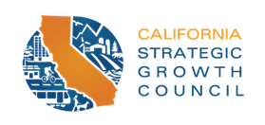

Section 5.A - Preliminary List of Preliminary List of State Funding Sources to Monitor
Grant Source | Description (Why it is relevant to this RFP) | URL
 | Run by California State, DGS, and Fi$Cal, caleprocure.ca.gov has postings of bid opportunities that can be filtered by category, such as sustainability efforts. | https://caleprocure.ca.gov/pages/Events-BS3/event-search.aspx
 | The State Library supports libraries with state-funded and federally-funded grants, statewide subscriptions to electronic resources, and statewide initiatives with partners offering further resources. | https://library.ca.gov/grants/
 | The Strategic Growth Council offers grants to support projects that promote sustainable and equitable community development, climate resilience, and natural resource conservation in California. | https://sgc.ca.gov/programs/
 | The Greenhouse Gas Reduction Loan Program provides grants to help finance projects that reduce greenhouse gas emissions in California, such as renewable energy and energy efficiency projects for buildings, transportation, and agriculture. | https://calrecycle.ca.gov/funding/
 | FedCenter stores grants ranging from various Federal, State, and non-profit organization grant opportunities, including but are not limited to: Air, Cleanup, Climate Adaptation, Energy, Environmental Justice, Sustainability, Water, etc. | https://www.fedcenter.gov/opportunities/grants/

Slide 15




Section 5.A - Preliminary List of State Funding Sources to Monitor
Grant Source | Description (Why it is relevant to this RFP) | URL
 | Integrated Regional Water Management (IRWM) grants are provided by the California Department of Water Resources to support collaborative efforts between regional stakeholders, such as water agencies, environmental groups, and local communities, to manage water resources in a holistic and sustainable manner, addressing issues such as water supply, water quality, and ecosystem health. | https://water.ca.gov/programs/integrated-regional-water-management
 | The California Office of Planning and Research provides grants to support research and planning efforts that advance sustainability, climate action, and equitable community development in California. | https://opr.ca.gov/sch/federal-grants/
 | The Storm Water Grant Program is a funding program provided by the California State Water Resources Control Board to support projects that improve stormwater management practices and reduce the amount of pollution and contaminants that enter California's rivers, lakes, and coastal waters through stormwater runoff. The program provides grants to local agencies, non-profit organizations, and educational institutions to implement projects such as green infrastructure, public education and outreach, and stormwater capture and reuse. | https://www.waterboards.ca.gov/water_issues/programs/grants_loans/swgp/prop1/
 | EPA awards more than $4 billion annually in funding for assistance agreements to state and local governments, tribes, universities non profit recipients, and other entities. | https://calepa.ca.gov/loansgrants/

Slide 16
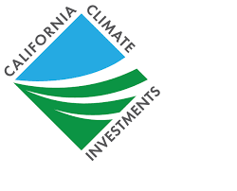
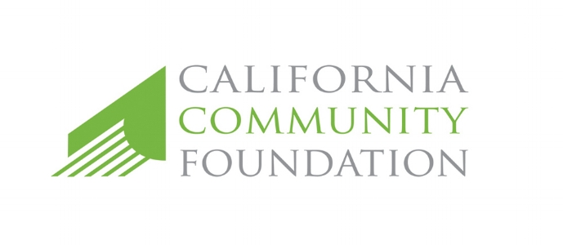
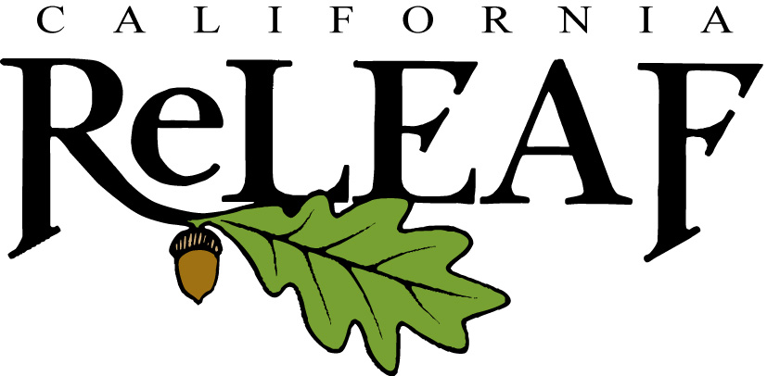

Section 5.A - Preliminary List of Private Funding Sources to Monitor
Grant Source | Description (Why it is relevant to this RFP) | URL
 | California Climate Investments puts billions of dollars of Cap-and-Trade auction proceeds to work reducing greenhouse gas emissions, strengthening the economy, improving public health and the environment, and providing meaningful benefits to the most disadvantaged communities, low-income communities, and low-income households. | https://www.caclimateinvestments.ca.gov/
 | CCF targets Los Angeles and aims to have nonprofit organizations be sustainable and viable. | https://www.calfund.org/nonprofits/how-we-work/sustainability/
 | California ReLeaf works statewide to promote alliances among community-based groups, individuals, industry, and government agencies, encouraging each to contribute to the livability of our cities and the protection of our environment by protecting, enhancing, and growing California’s forests. | https://californiareleaf.org/resources/public-grants/
 | FedCenter stores grants ranging from various Federal, State, and non-profit organization grant opportunities, including but are not limited to: Air, Cleanup, Climate Adaptation, Energy, Environmental Justice, Sustainability, Water, etc. | https://www.fedcenter.gov/opportunities/grants/
 | Instrumentl is one of the most comprehensive sources of grant and funder data in the world, and has hundreds of postings a year regarding energy efficiency and environmental conservation grants. | https://www.instrumentl.com/browse-grants/grants-for-environmental-conservation

Slide 17






Preliminary List of Private Funding Sources to Monitor
Grant Source | Description (Why it is relevant to this RFP) | URL
 | NEEF offers grants and awards to help organizations engage their local community to improve the environment, increase diversity, and expand their work locally. | https://www.neefusa.org/grants
 | NSI is an LA-based fund that invests in nonprofit resiliency during moments of organizational transformation. They are supported by 20 different foundations and fiscally sponsored by the California Community Foundation. | https://www.calfund.org/nonprofits/how-we-work/sustainability/nsi/
 | Every year, PG&E Corporation Foundation requests proposals of $100,000 to fund four projects that build community resilience and capacity to withstand climate-related hazards. | https://www.pge.com/en_US/residential/in-your-community/local-environment/resilient-communities/resilient-communities-grant-program.page
 | SMUD Shine awards looks for projects that support and revitalize local communities within areas that SMUD serves, primarily projects that include neighborhood revitalization, energy-efficiency, energy conservation, or clean energy solutions. | https://www.smud.org/en/Corporate/Landing/Sustainable-Communities/Shine-awards
 | Society for Nonprofits funds a multitude of grants, and has raised millions of dollars towards grants focusing on funding environmental sustainability. | https://www.snpo.org/index.php
 | The Solutions Project has multiple Grantee Partners which aim to fund and amplify climate justice solutions created by frontline communities building an equitable and regenerative economy. | https://thesolutionsproject.org/

