Slide 2
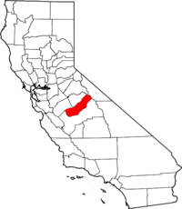
Madera County
Sustainable Groundwater Management Act (SGMA) requires counties to represent land that is not represented by other agencies
Board of Supervisors is the Board of Directors
County Groundwater Sustainability Agency (GSA) is really three separate GSAs

Slide 3
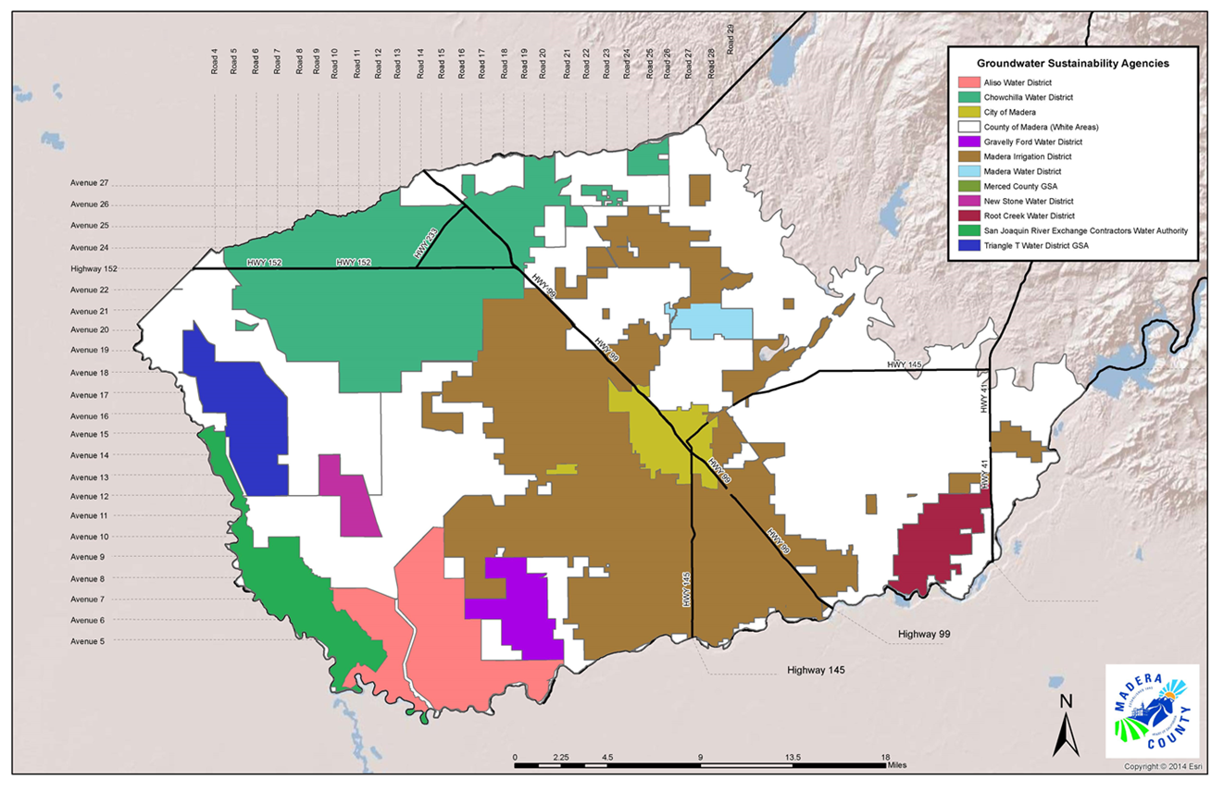
Groundwater Sustainability Agencies

Slide 4
Ag and Urban Water Use
91% of water use is agricultural in Madera subbasin
Groundwater balance ordinance requires a 1:1 water balance for new residential development
Every gallon extracted must be replenished

Slide 5
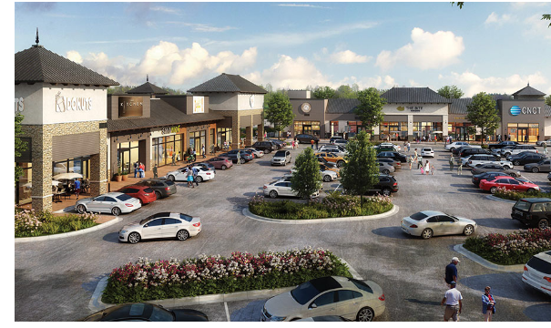
Urban UseUse
Tesoro Viejo
  New single family homes in master planned community
  Commercial development as well as homes
  Water supply is San Joaquin River
  Existing water right
  Jurisdiction of Madera Irrigation District GSA
Riverstone
  New single family homes in master planned community
  Commercial development as well as homes
  Water supply is purchased water and groundwater
  Jurisdiction of Root Creek Water District GSA

Slide 6
We Adopted Allocations
Ag Allocation Snapshot
A water budget with penalty measured in inches of water (ETAW)
Sustainable Yield – “safe yield”
Transitional Water – “overdraft”
Can be shared within farms in a farm unit zone
Decreases over time as a step function
Developed by an Advisory Committee of farmers of all sorts and residents
Won an award from the California State Association of Counties

Slide 7
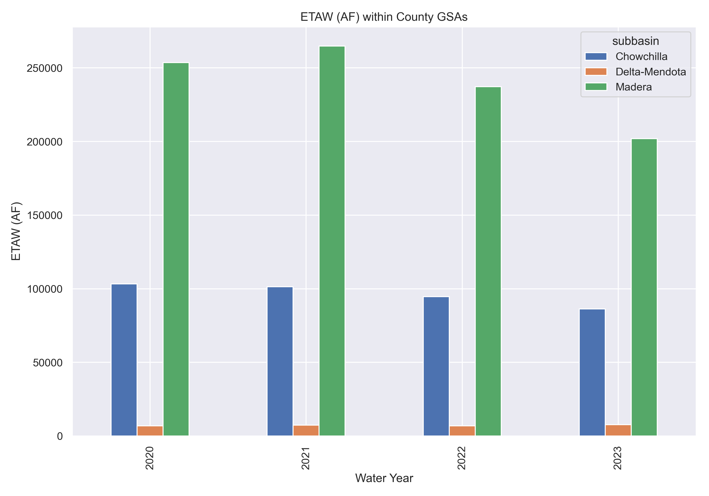

Slide 8
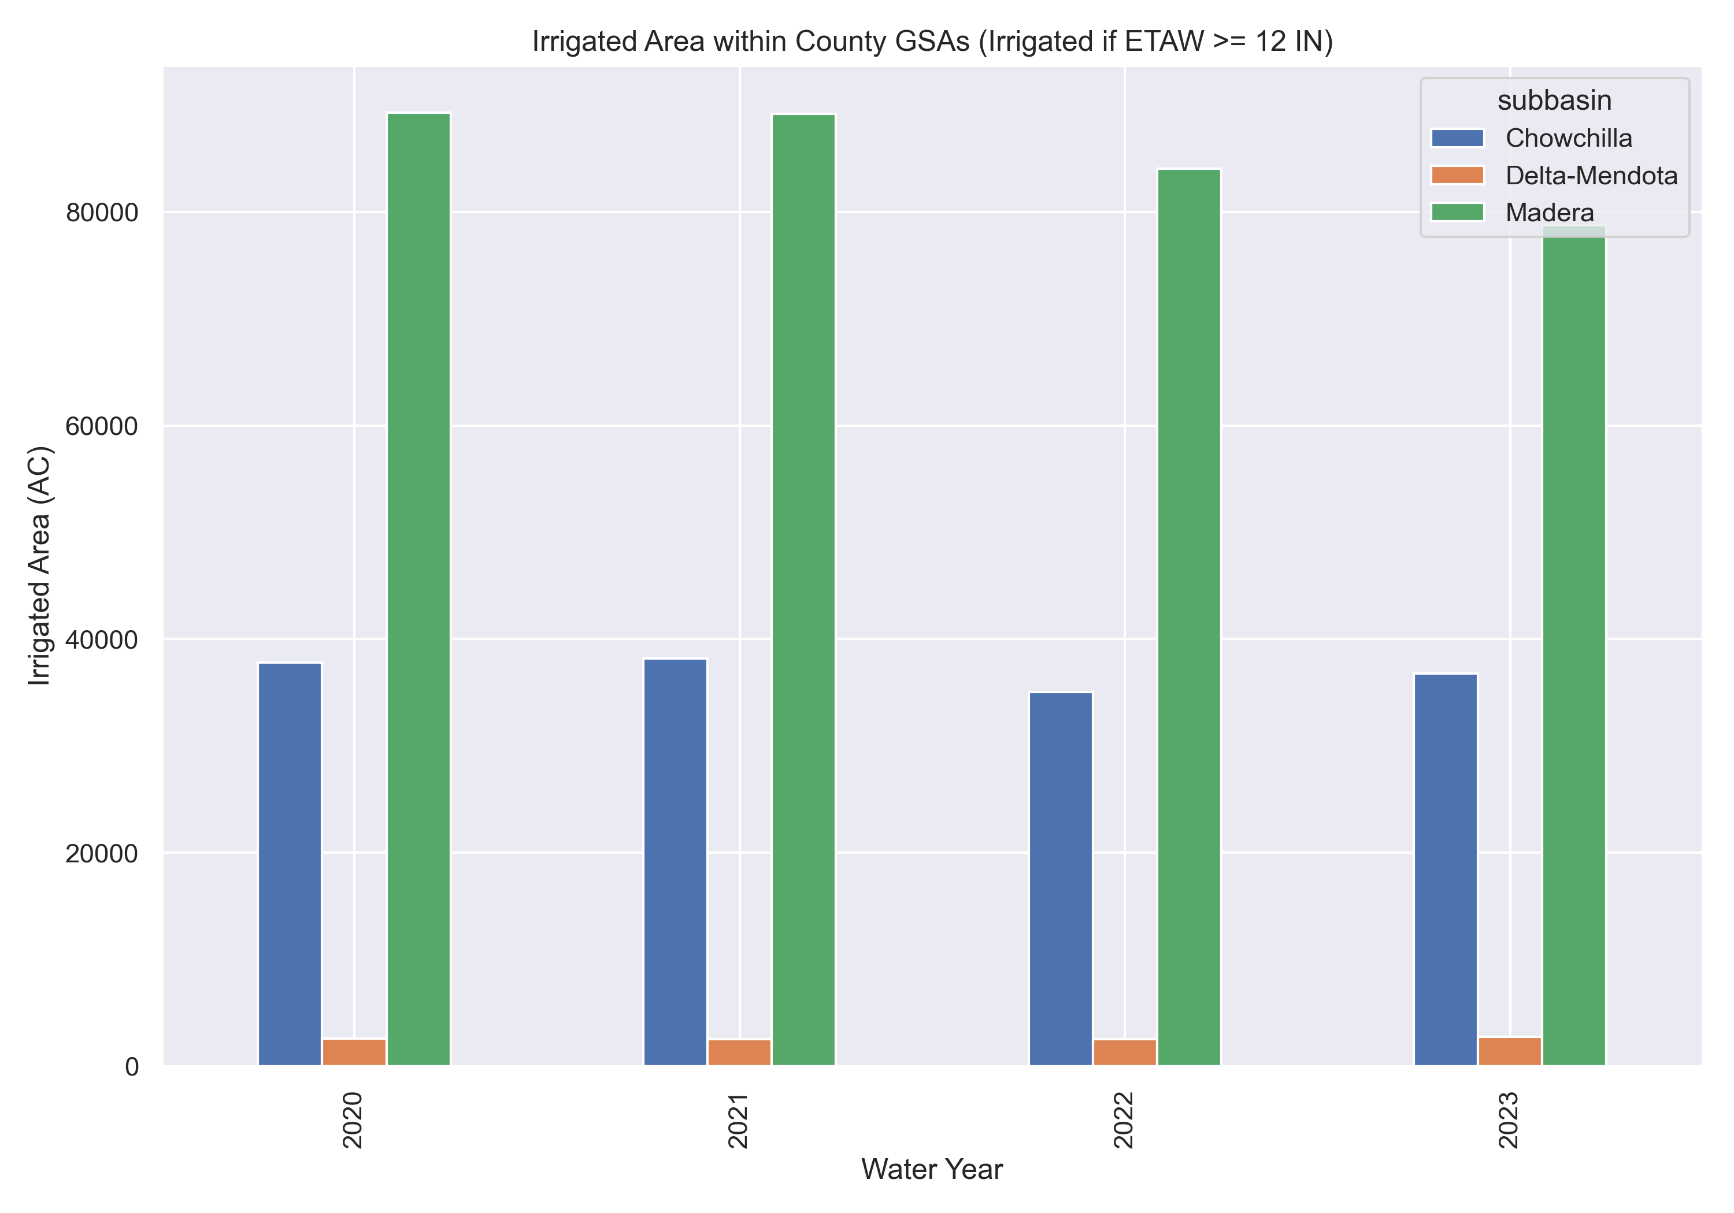

Slide 9
Stephanie Anagnoson
Director of Water and Natural Resources
(559) 598 – 0362
Stephanie.Anagnoson@maderacounty.com.

