Slide 1
Addressing Ageing Infrastructure by Improving Drinking Water Distribution and Sewer Collection Systems in Portola, California
Pablo K. Cornejo
Department of Civil Engineering
California State University, Chico

Slide 2
Outline
Background
Motivation
Goals
Economic Analysis Results
Conclusions
Ongoing Work

Slide 3
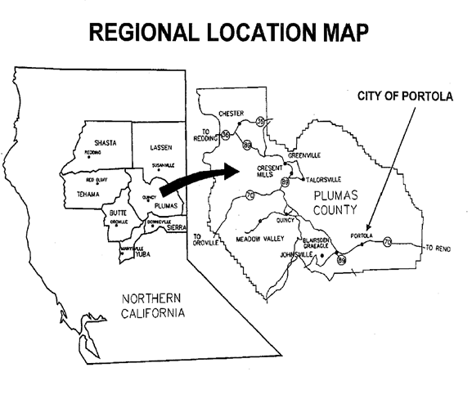
Introduction
City of Portola: economically disadvantaged community in Northern California
~2,000 residents
Challenges with ageing infrastructure
Water distribution and sewer collection
Reaching life expectancy
High risk of failure

Slide 4
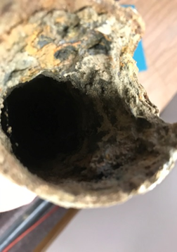
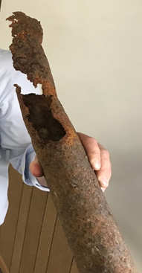
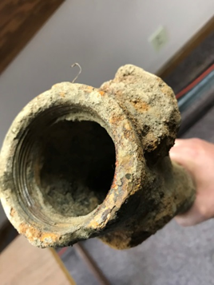
Key Challenges
Antiquated piping system
Limited upgrades since 1950s
Piping materials of concern
Asbestos cement pipe – 52% of total length (water)
Water quality and quantity concerns (I&I)

Slide 5
Background
WRPI’s Center for Disadvantaged Communities
Engaging CSU engineering students on technical assistance project aimed at improving water and wastewater infrastructure through Proposition 1 Funding
Technical Assistance Group
Executive Director of WRPI – Boykin Witherspoon III
Project managers, WRPI senior personnel, and staff – Roger Shintaku, Tim Clark, Sargent Green, Melissa Moreno, Tamra Fukumoto
CSU faculty – Jackson Webster, Pablo K. Cornejo, Marie E. Patterson
WRPI staff and CSU students: Uriel Dominguez, Andres Ramirez, Aurora Diaz, Jonathan Campos, Dylan De Leon, Mekena Galka, Wesley Miller, Ethan Retherford, Dylan Yamasaki, Jason Blum, Nicholas Mclean, Benjamin Nichols, Rafael Cervantes, Natali van Leeuwen, Karen Martinez, Holly Stein, Alec Dominguez
Notes:
Instead of paying a high cost consulting company
The State has allowed CSU engineering students to tackle the project under advising of faculty. This project provides real world problem solving while addressing pressing issues for California communities

Slide 6
Big Picture
CWSRF Alternative
City willingness to borrow & limitations on state grant amount
DWSRF Alternative
Preliminary design of alternatives considered
- Mapping
- Trench dimensions
- Selection of materials
DWSRF development must be in the context of CWSRF
Preliminary design of alternatives considered
- Mapping
- Trench dimensions
- Selection of materials
DWSRF needs to consider avoided costs related to CWSRF
Economic analysis of alternatives and selection
Economic analysis of alternatives and selection
DWSRF needs to consider overall system reliability, and public interest/safety independent of CWSRF
Select project
Select project

Slide 7
Project goals
Overall goal: Engage CSU engineering students to tackle the project under advising of faculty. This project provides real world problem solving while addressing pressing issues for California communities.
The rest of the presentation focuses on cost feasibility of water distribution:
Option 1: Limited Action
Option 2: Critical Infrastructure Replacements
Option 3: Full System Replacement
Notes:
Considered avoided costs associated with replacing water and sewer lines concurrently
Submitted technical report to State Water Resources Control Board for approval of funding

Slide 8
Option | Description | Coverage (%) | Pros | Cons
Option 1 – Limited Action | Replace water lines co-located with CDBG sewer lines proposed to be replaced | 14% | -New piping reduces risk of breakage during sewer line replacement | Limited benefits in: -Public safety -Reliability of social services
Option 2 – Critical Infrastructure | Replace city’s water lines in areas with critical infrastructure (hospitals, schools, government buildings) | 25% | Increases: -Public safety -Reliability of social services | Limited benefits in: -Reducing water loss
Option 3 – Complete System Replacement | Complete replacement of water distribution system | 100% | Maximizes: -Public Safety -Reliability | -Higher capital cost -May face challenges in getting approval for funding

Slide 9
Project evaluates Cost and ROCOF
Break-in period
Wear-out
period
Useful life period
Risk of Occurrence of Failure
Time (years)
Risk of occurrence of Failure (ROCOF) model. Adapted from Rogers and Grigg, 2009).

Slide 10
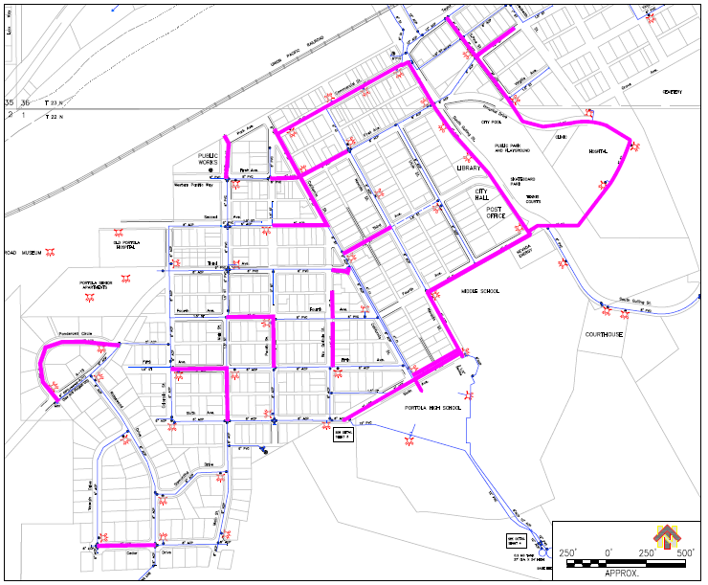
Water Distribution Inventory
Inventory developed based on existing system
Mapping
Trench Dimensions
Selection of materials
Construction material and processes were defined:
Excavation, demolition, bedding, backfill
Piping, valves, elbows, hydrants, asphalt
The inventory used for cost estimation
Used WaterCAD to assess hydraulic performance
Critical infrastructure replacements for south system

Slide 11
Cost Estimation:
RSMeans was used to get estimation for the construction costs
Construction material
Equipment and labor
Operation and maintenance
O&M and replacement costs based on historical data
Costs avoided based on improvements in system
Estimated life cycle costs over 20 years at a 6% discount rate
Present Value ($)
Equivalent Uniform Annual Cost ($/year)

Slide 12
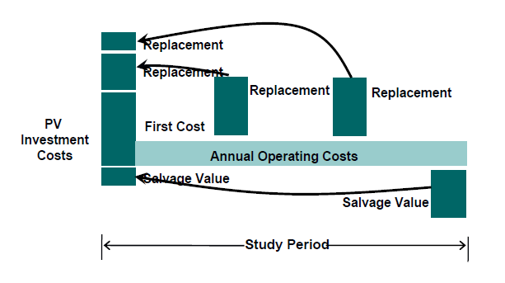
Life Cycle Cost Analysis (LCCA) LCCA is used to compare the economic impacts of alternatives
Notes:
Life cycle cost analysis (LCCA) used to calculate costs over the life of a system
Cost of infrastructure for specific technologies
Major Equipment
Tanks
Cost of Operation and Maintenance
Chemicals
Electricity
Equipment replacement
Outputs
Equivalent uniform annual costs (EUAC)
Net present value (NPV)

Slide 13
Water Distribution Cost Estimate – Feasibility Study
Cost Summary | Limited Action | Critical Infrastructure Replacement | Full Replacement
% of Water Distribution System Replaced: | 14% | 26% | 100%
Northside Capital Cost ($): | $852,073 | $1,383,564 | $7,329,686
Southside Capital Cost ($): | $678,045 | $1,729,491 | $4,758,447
Total Capital Cost ($): | $1,530,117 | $3,113,055 | $12,088,133
O&M + Replacement Cost($/year): | $903,290 | $719,444 | $488,248
Present Value (PV): | $11,890,786 | $11,365,025 | $17,688,297
Equivalent Uniform Annual Cost (EUAC): | $1,036,693 | $990,855 | $1,542,146

Slide 14
Additional costs avoided by concurrent replacement of water and sewer lines
~21% of costs avoided by replacing water and sewer lines concurrently:
Mobilization
Traffic control
Environmental Permitting
Cost Avoided for Critical Infrastructure Option.
Critical Infrastructure | Cost w/ Avoided Costs | Cost Savings
Total Capital Cost ($): | $2,657,486 | $455,569
Operation & Maintenance + Replacement Cost ($/year): | $719,444 | $183,846
Present Value (PV): | $10,909,456 | $2,564,267
Equivalent Uniform Annual Cost (EUAC): | $951,136 | $223,564

Slide 15
Conclusions
Option 1 (Limited Action) – Least beneficial
No concurrent replacement with sewer lines
Highest risk of failure
Option 2 (Critical Infrastructure): lowest present value
Increases benefits to public safety and reliability of critical infrastructure
Only 26% of the city covered
Option 3 (Full replacement): highest cost
Increases benefits to public safety and reliability throughout city
Lowest risk of failure
Notes:
Recommended: Option 2 or 3 depending on funding availability and city’s willingness to borrow money.
Cost savings emerge by only shutting down the street once and avoiding the cost of mobilization (5%), traffic control (6%), and environmental permitting (10%) on two separate occasions.

Slide 16
Ongoing Work
SewerCAD: hydraulic performance modeling
Cost estimate for replacing wastewater collection: RS Means and LCCA
Asset Management Plan: long-term economic planning (prioritization)
Construction Scheduling: timeline for wastewater improvements
CalEEMod: GHG emissions modeling of construction activities
PORTOLA
PROJECT

