Slide 1
A Sustainable Water Future for California: Communicating to the Public and Media
Jennifer Bowles
Executive Director
Notes:
Has anyone heard of the Water Education Foundation? Has anyone used our materials in class before? I know a professor at San Francisco State does though she’s not here today. We were born in 1977 and we are essentially a rag-tag group of journalists and teachers, who are passionate about water. We hold conferences on hot topics, workshops on important matters such as the Sustainable Groundwater Management,

Slide 2
Who We Are
Impartial nonprofit focused on public education of western water issues since 1977
Ragtag group of journalists and teachers
Volunteer Board of Directors representing diverse viewpoints and stakeholder groups
Mission: Create a better understanding of water resources and foster public understanding and resolution of water resources issues through facilitation, education and outreach.
Notes:
Consider your source….who here knows the water education foundation? Have you ever used our materials, attended an event?

Slide 3
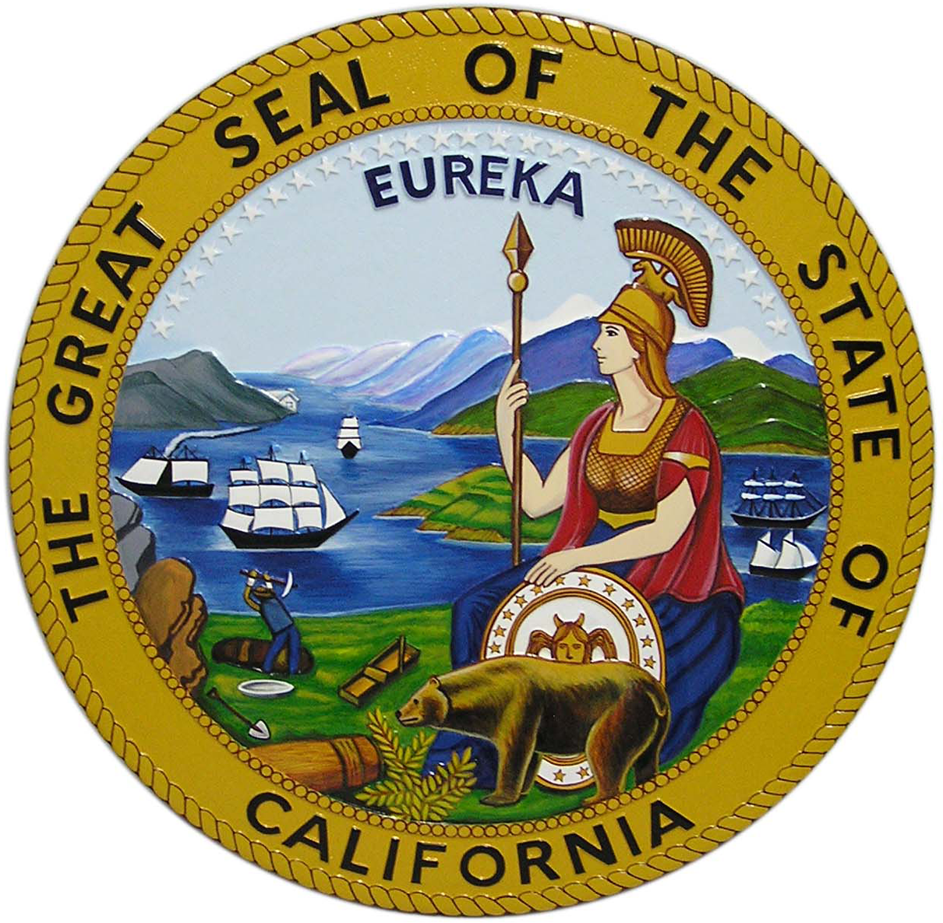
The Lifeblood of the State
Notes:
Consider your source….who here knows the water education foundation? Have you ever used our materials, attended an event?

Slide 4
Context is half the battle!
Notes:
When communicating water to the public in California, context is everything. We just heard about efforts to make groundwater sustainable. Why should the public care, why should anyone care? Isn’t that just what farmers use to put on their crops? The answer is no. Depending on where you live, you may be hugely dependent on groundwater to drink , wash your clothes and take a shower.. If you live in Chico that’s the case, if you live in Riverside, just a few miles south of Cal State San Bernardino, you are nearly 100 percent dependent from water, and much of that water comes from groundwater below san Bernardino. If you are from San Diego State, there is virtually no groundwater. Your water is coming from a variety of sources, including the ocean. Anyone here from San Francisco State, you get most of your water from a National Park, Yosemite in fact. I always like to start off our Water 101 Workshop with the phrase: There’s a story behind every drop of water that comes out of your faucet. And not only how it gets from point A to Point B, but what happens in between. so for us, the number one thing we try to get across to folks is where
And Oroville Dam. If I’m in Southern California, why should I care what’s happening to this dam way north of Sacramento? We know because it’s the heart of the State Water Project, that brings water xxx miles south to Southern California. So t all comes back to communicating to the public where does their water come from. And

Slide 5
How water moves in California is the other half!
Notes:
So we are big on visuals when it comes to telling the water story. We sell water maps, which are on display here. California is so well plumbed it’s unlike most states. It’s really unique. We use graphics with all of our publications and when we do news articles for Western Water magazine.

Slide 6
Plus cool graphics!
Notes:
So we are big on visuals when it comes to telling the water story. We sell water maps, which are on display here. California is so well plumbed it’s unlike most states. It’s really unique. We use graphics with all of our publications and when we do news articles for Western Water magazine.

Slide 7
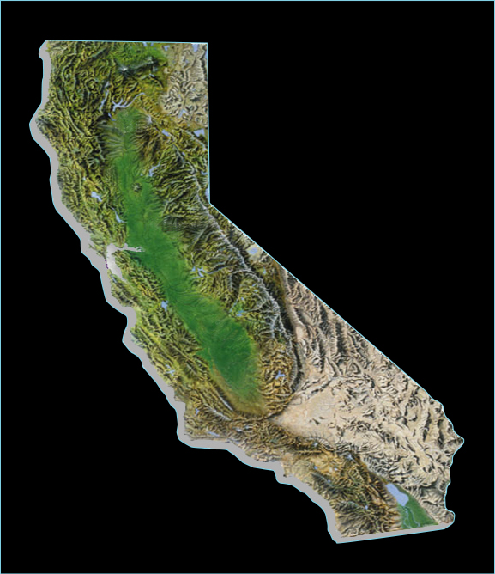
California Water Development
Hetch Hetchy System
San Francisco PUC
1913 - Raker Act
Los Angeles Aqueduct
Los Angeles DWP
1913
CVP
Mokelumne River Aqueduct
Mokelumne River Aqueduct
East Bay MUD
1929
Hetch Hetchy System
Los Angeles Aqueduct
Central Valley project
U.S. Bureau of Reclamation
1940 (C.C. Canal first)
SWP
Colorado River Aqueduct
MWD of So. Cal.
1941
Colorado River Aqueduct
State Water Project
California DWR
1960 - Burns Porter Act
Notes:
The Central Valley Project (CVP) was originally conceived as a State project to protect the Central Valley from crippling water shortages and devastating floods. The basic concept and facilities of today's massive project were included in the State Water Project formulated in the 1930's. In the depression era, however, the State was unable to finance the project. Most of the water development envisioned by the State was accomplished by the Federal CVP, beginning with its initial authorization in 1935.
Work began in 1937 with the Contra Costa Canal which began delivering water in 1940. The next facility built was Shasta Dam, the keystone of the project. Work on the dam began in 1938, and water storage started even before its completion in 1945. Congress subsequently passed 13 separate measures to authorize the development of other major project facilities over the next 3 decades. The final dam, New Melones, was completed in 1979.
EBMUD is formed in 1923. In 1929, water itself reached the East Bay Area when East Bay Municipal Utility District voters completed Pardee Dam and the 82-mile long Mokelumne Aqueduct.
SWP - 1960 California voters approved the $1.75 billion Burns-Porter Act bond issue to begin building the State Water Project (SWP). The Project was designed and constructed by the Department of Water Resources. By 1973, the initial facilities were completed and water delivery to southern California began.
1971 On October 8, Governor Ronald Reagan starts the first pump at A.D. Edmonston Pumping Plant, as part of a ceremony celebrating the first water deliveries to Southern California.
LADWP: In 1907, the voters of Los Angeles again gave their overwhelming endorsement to this project, approving a $23 million bond issue for aqueduct construction. The only task that remained was to build it.
This is a big visual we use in our Water 101 workshop because it really shows how water moves through the state.

Slide 8
Notes:
We have an entire page devoted to helping people understand that there water comes from places other than their taps. They can click on the area they live and find the source or sources. So this is something simple to show your students, the public or anyone else who is curious.

Slide 9
During the last drought . . .
Notes:
Drought faq,, because my friends on facebook, posted the map of California, with a question over the ocean, inferring that we have a huge supply of water in our backyard… also water can onservation tips and the fact the your law can suck up to 50 percent of your total home use…

Slide 10
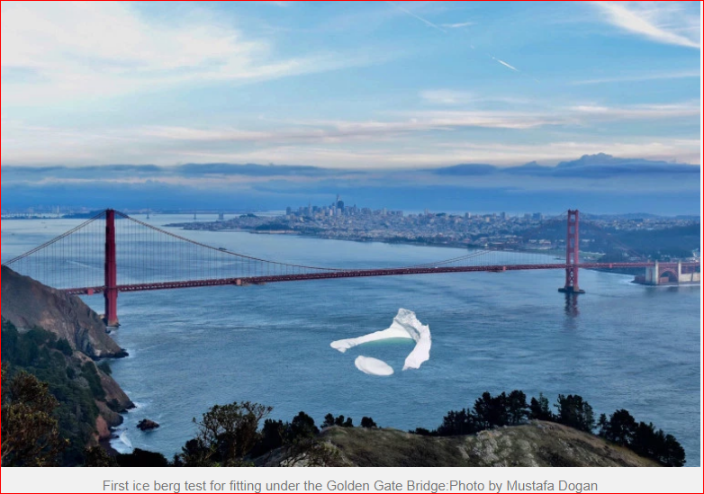

Slide 11
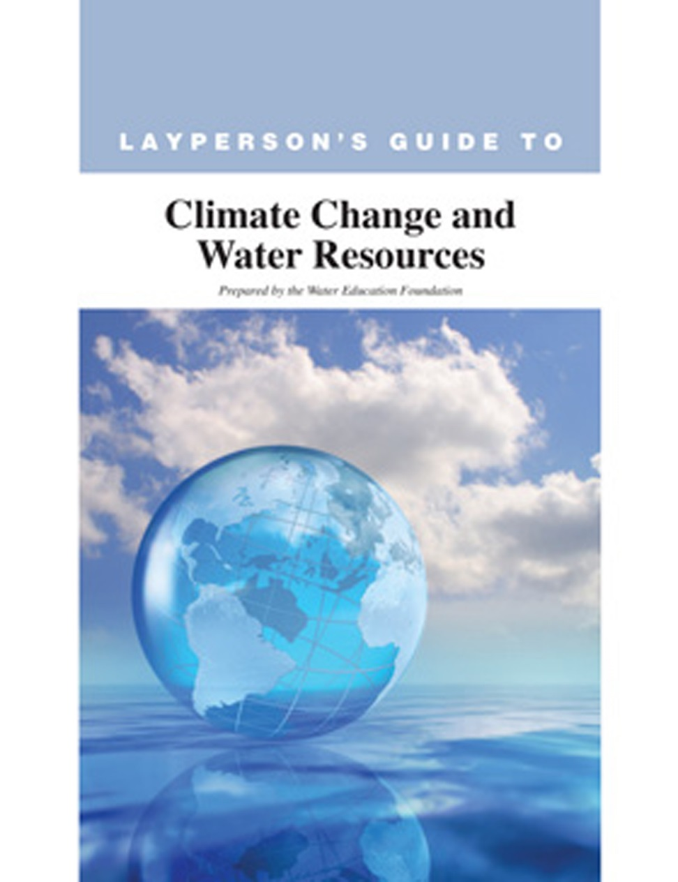
Understanding Climate Change: 2017
Notes:
We’ve been writing about climate changes since at least the 1990s … in our Western Water magazine, but we added this guide to our series of guides on key water topics because we thought it was important to learn.

Slide 12
Education: How We Do It
Provide Information via the written word/graphics:
News/Guides on key water topics
Online encyclopedia
Water Maps
Website: Free tool for research and news
Social media
In-Person Events:
Water tours
Conferences and workshops
Water Leaders class
K-12 teacher education programs - Project WET
Notes:
We break it down into two categories, but really three. First we write about stuff. Then we take people to see water in motion and we do inperson workshops, conference … we have a year long water leaders class for early to mid career professionals…

Slide 13
www.watereducation.org

Slide 14
AQUAFORNIA – Daily Top Water News
Top water news from California and the West in an easy-to-read headline format
Updated Monday through Friday
Impartial ranking of article importance
Can use in your classes or tell media you work with to sign up
Notes:
Students or media new tey can subscribe to this …. o the water beat tdentstdudentstEvery week day we put out the top water news from around the state, anyone can subscribe to it. You can have your students and colleagues subscribe to it.

Slide 15
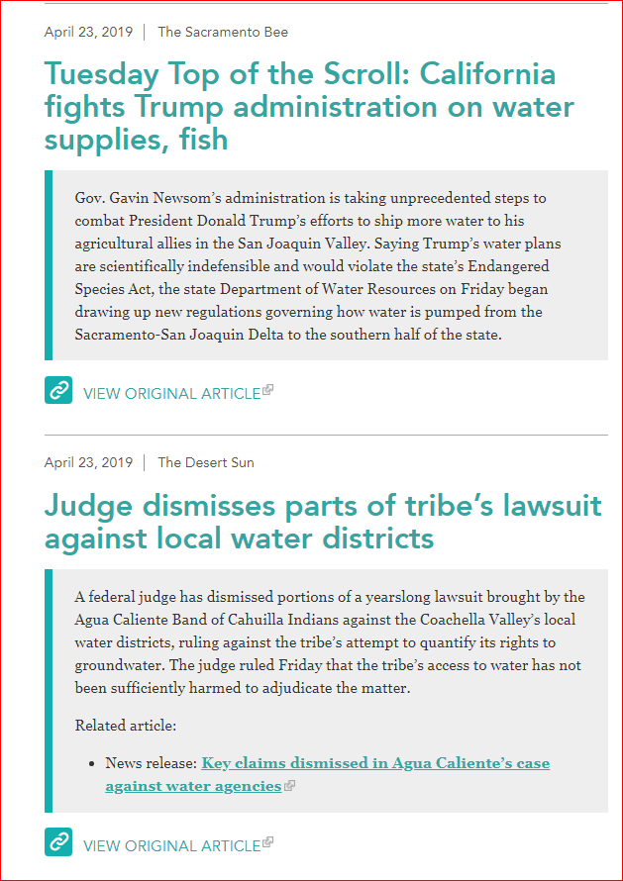
Notes:
Every week day we put out the top water news from around the state, anyone can subscribe to it. You can have your students and colleagues subscribe to it.

Slide 16
AQUAPEDIA: Online Water Encyclopedia
Terms and issues
Historical water people
Timelines
We send out a “word of the week” based on news headlines or special event such as Earth Day or World Water Day to give deeper context to items
Can use in your classes or tell media you work with to sign up
Notes:
Every week day we put out the top water news from around the state, anyone can subscribe to it. You can have your students and colleagues subscribe to it.

Slide 17
Notes:
National groundwater awareness week in march; in September, protect your groundwater day….

Slide 18
Western Water News
Western Water is the only publication in the West to focus exclusively on in-depth coverage of water resource issues.
Find it online, with expanded coverage and new features, at www.watereducation.org/WesternWater

Slide 20
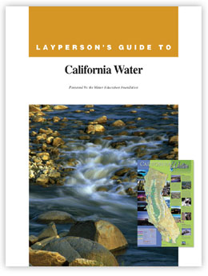
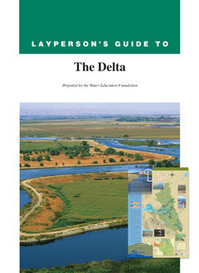
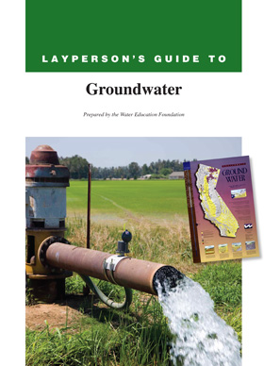
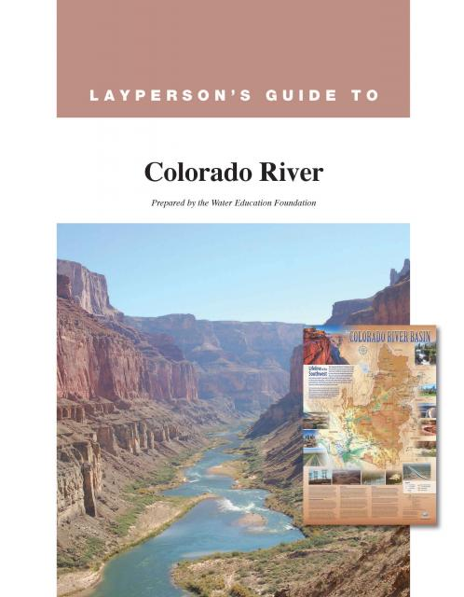
Layperson’s Guides
All 16 guides are an excellent resource for researchers, reporters, lawmakers, students and the public
· Agricultural Drainage · California Water
· California Wastewater · Central Valley Project · Climate Change
· Colorado River
· Colorado River Delta
· The Delta
· Flood Management
· Groundwater · Integrated Regional Water
Management
· State Water Project · Water Conservation · Water Marketing · Water Recycling · Water Rights Law

Slide 21
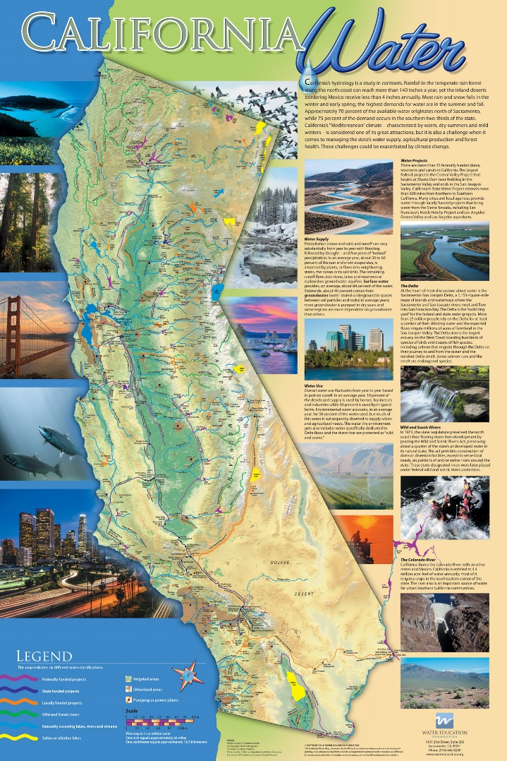
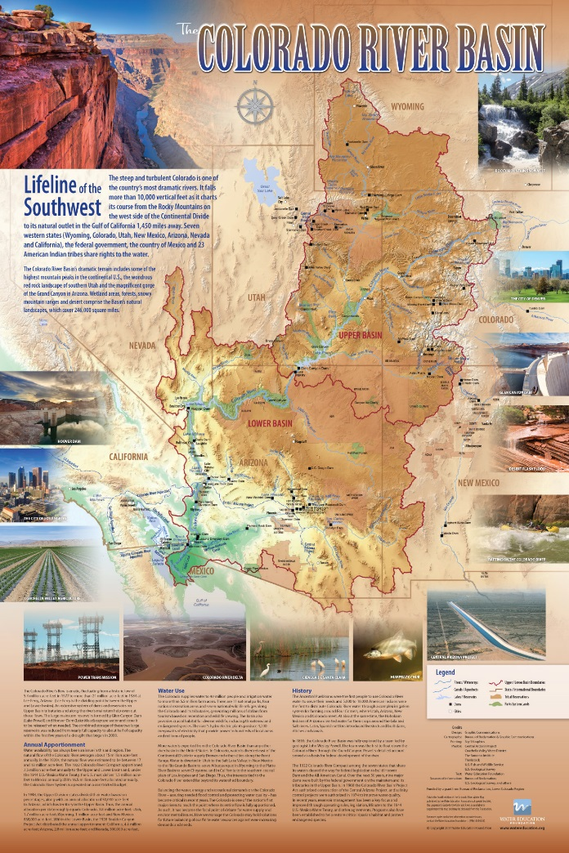
Written Word and Cool Graphics!
Going back to the plumbing
Understanding the plumbing and geography in California is half the battle

Slide 22
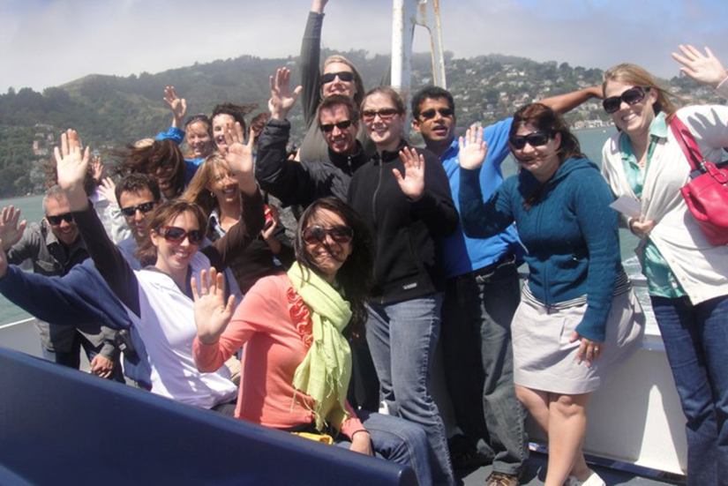
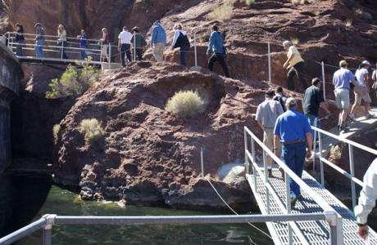
Water Tours
Six major tours most years, taking people to the source
Central Valley, Lower Colorado River, Bay-Delta, Headwaters, Northern California and Central Coast
Some Cal State teachers do their own water tours!

Slide 23
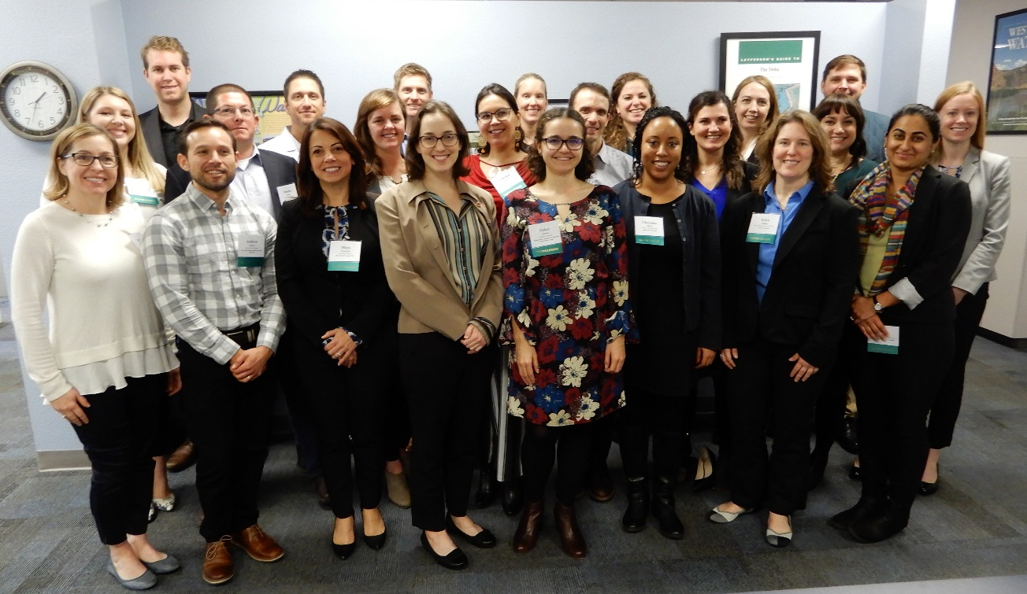
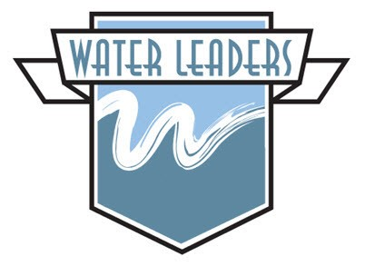
Water Leaders Class
One-year program identifies up-and-coming community leaders from diverse backgrounds and educates them about water issues.
The program enhances individual leadership skills and prepares participants for decision-making about water resource issues.
Leading stakeholders and top policymakers serve as mentors to class members.

Slide 24
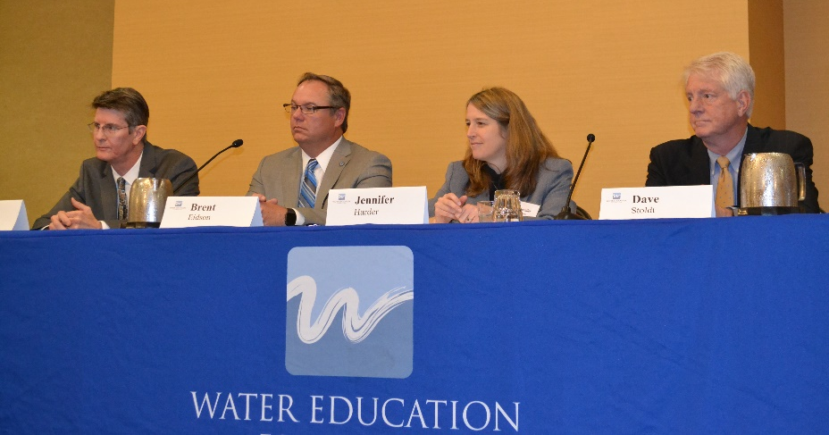
Conferences/Workshops
The Foundation coordinates an annual conference known as the Water Summit, along with events and workshops devoted to specific issues.
· Climate change · The Delta · The Colorado River
· Flood management · Water 101 · Agriculture
· Drought · Groundwater/SGMA · Subsidence

Slide 25
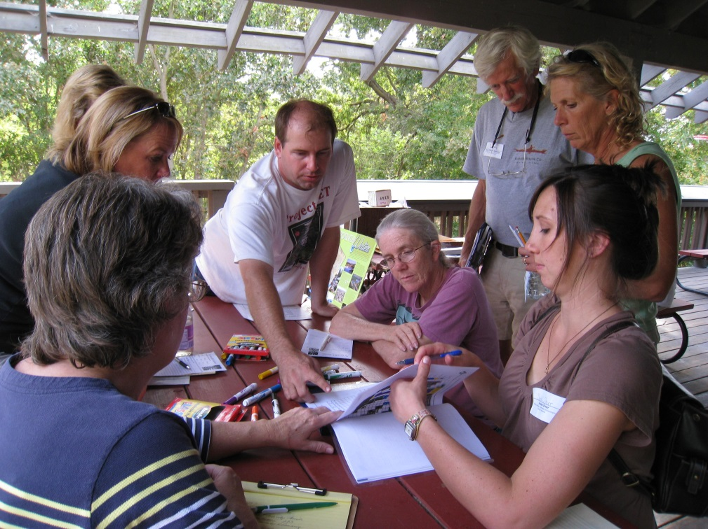
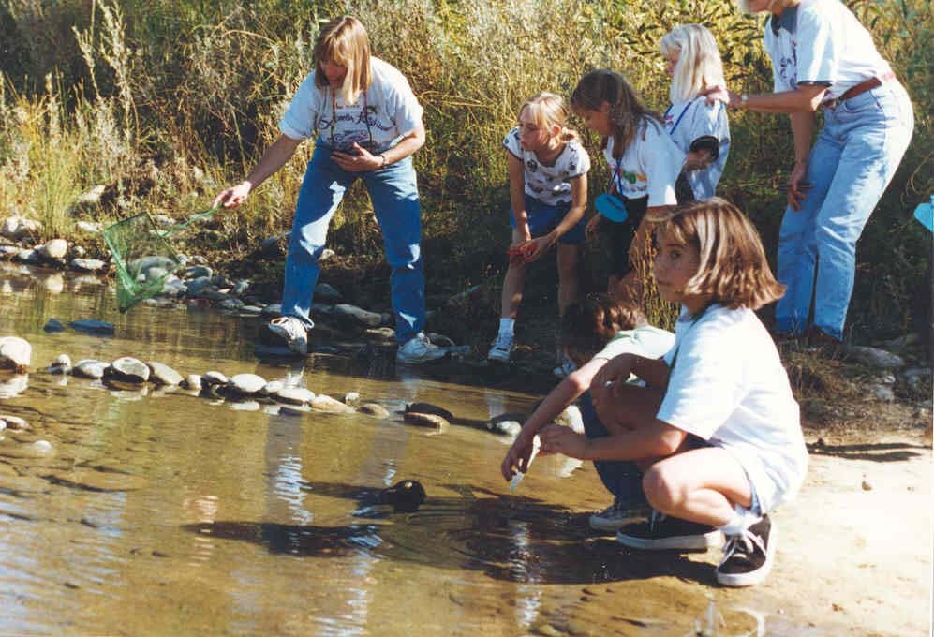
Project WET Workshops
California coordinator for international program
Workshops for K-12 educators to incorporate water science and current issues into their classrooms
Trainings for professors so they can integrate into courses for new teacher credential candidates and natural resource interpretation students at various universities, including Chico State!

Slide 26
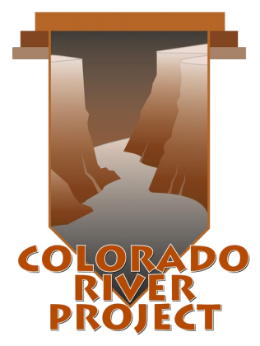
Colorado River Project
Educates people about challenges facing the Upper and Lower Colorado River Basins
Includes:
Lower Colorado River Tour
Lower Colorado River Map
Layperson’s guide to the Colorado River
and the Colorado River Delta
Western Water news articles
And more!
Notes:
sada

Slide 27
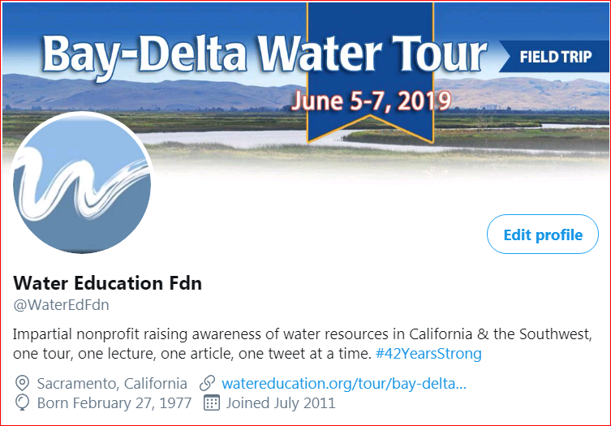
Social Media
Notes:
We communicate big time through social media. We are active on facebook, linkedin and twitter. I would say twitter

Slide 28
Working with the Media
Be on Twitter
Use the hashtag: #cawater
Reporters want to know:
How is your project or research going to affect their readers/the public
So give them the context
Use cool graphics!

Slide 29
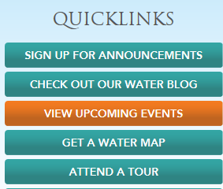
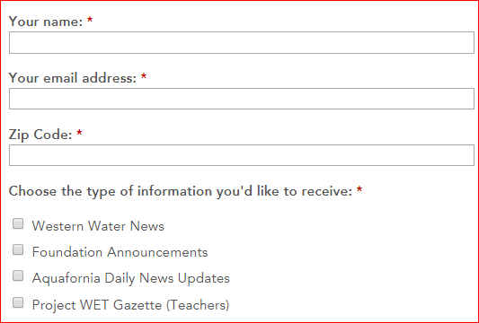
Sign up for Western Water / Aquafornia
Go to Quicklinks at www.watereducation.org

Slide 30
Stay in Touch
Jennifer Bowles, Executive Director
jbowles@watereducation.org
916-444-6240

