Slide 1
Academic Planning Summit
Developing Self-Support Programs
June 6, 2017
CSU Chancellor’s Office
Notes:
The California State University

Slide 2
EO 1099

Slide 3
Where is EO 1099?
http://www.calstate.edu/app/
Link: Policies

Slide 4
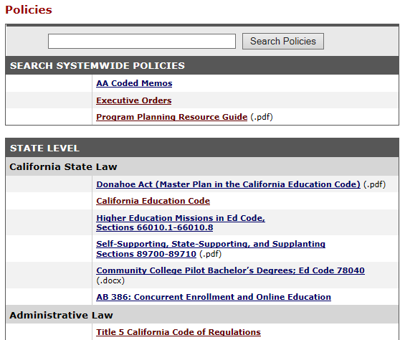
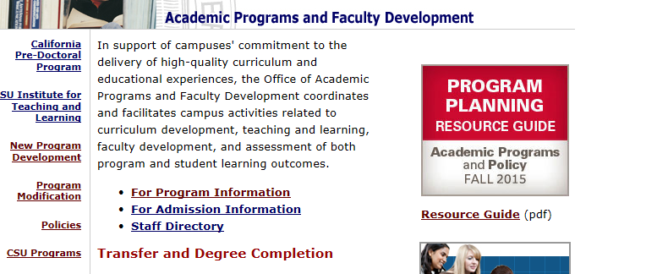

Slide 5
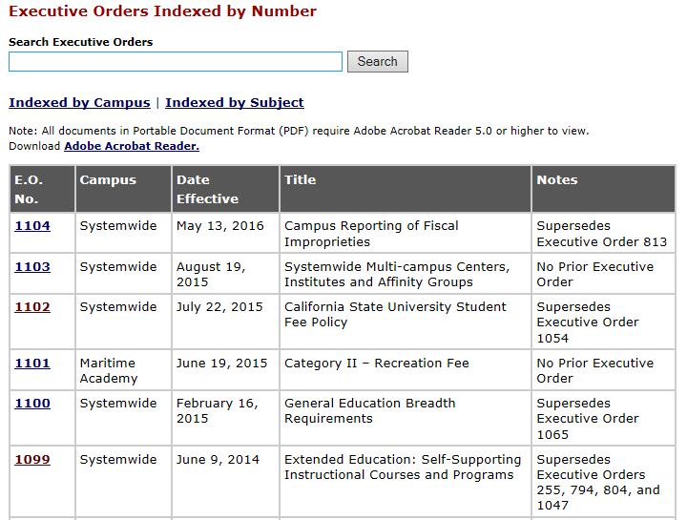

Slide 6
Self-Support Program Proposal Qualifying Criteria

Slide 7
Self-Support Program
Proposal Qualifying Criteria
1. Confirm – NO SUPPLANTING
2. Explain – state-support funding unavailable or inappropriate.

Slide 8
3. Explain how at least one of the following additional criteria shall be met:
  career enrichment or retraining
  location removed from campus
  distinct technology–online delivery
  additional expensive services offered
  outside financial support ended

Slide 9
Reminder - Contracts Associated with Degree Programs
Include copies of any contracts or agreements made between parties with an interest in operating the proposed program.
Other entities may include academic departments, academic institutions, foundations, vendors or similar. Please include a copy of the agreement and an e-mail or other evidence that the campus attorney has approved the agreement.

Slide 10
Adding a Self-Support Counterpart to a Previously Approved
State-Support Program

Slide 11
Adding a Self-Support Counterpart to a Previously Approved State-Support Program
EO 1099 5.2
  self-support not supplanting existing state-support
  specify qualification(s) to operate
  provide rationale
  detailed cost-recovery budget
  adequate faculty resources
  anticipated impact

Slide 12

EO 1099 4.2
  academic standards and requirements for state-support on-campus educational programs are the same for comparable extended education instruction

Slide 13

Sample Budget Template

Slide 14
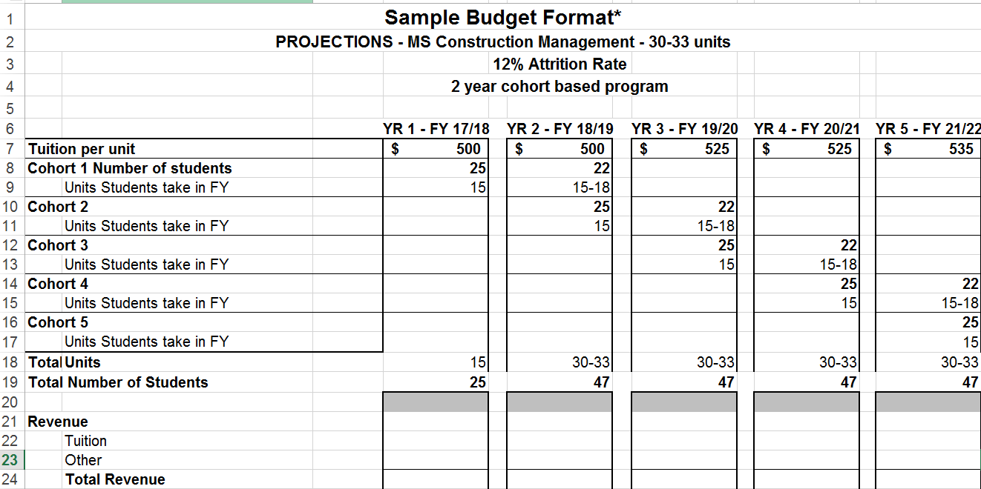
Total cost to students = $16,500

Slide 15

Budget – things to remember
anticipated enrollment
(including attrition)
three-to-five year projection
(demonstrates sustainability)
price per unit
overall program cost to students
maintain auditable records (EO 1099 13.4.4)

Slide 16
Where is the self-support sample budget template?
http://www.calstate.edu/app/program_dev.shtml

Slide 17

Cal State LA’s Budget Model
presented at
CSU Academic Planning Summit
Thomas Pokladowski, J.D.
Assistant Dean
College of Professional and Global Education

Slide 18
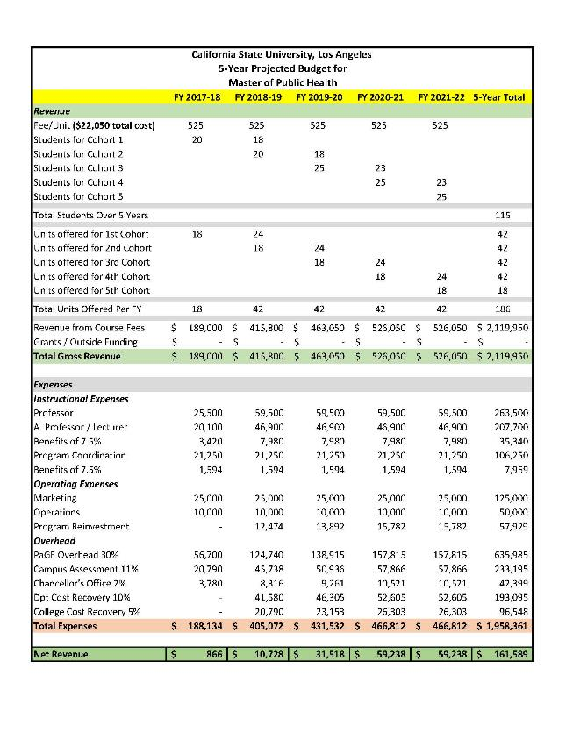
Accounts for attrition
Year 1 is 9 + 9 units
Year 2 is 6 + 9 + 9 units
Model allows for outside funding
Anticipates mix of faculty levels and faculty coordination
Ops includes supplies, travel, hospitality, accreditation

