Slide 1
Degrees Database Overview and Reports Updates
Academic Planning Training Summit
June 6, 2017
CSU Chancellor’s Office
Notes:
The California State University

Slide 2
Welcome to the Degrees Database (DDb)
PeopleSoft environment
Stand-alone database—not tied to campus student system
PeopleSoft familiarity is there
Notes:
In this presentation, I will be providing a brief overview of the Degrees Database for those of you who are new, but mainly I will be detailing the various reports available for your use on the campus.
The Degrees Database is housed in an independent PeopleSoft environment. Although it may look familiar to those of you using PeopleSoft on campus, it is not connected to the campus student system. It has a separate login and exclusive data.

Slide 3
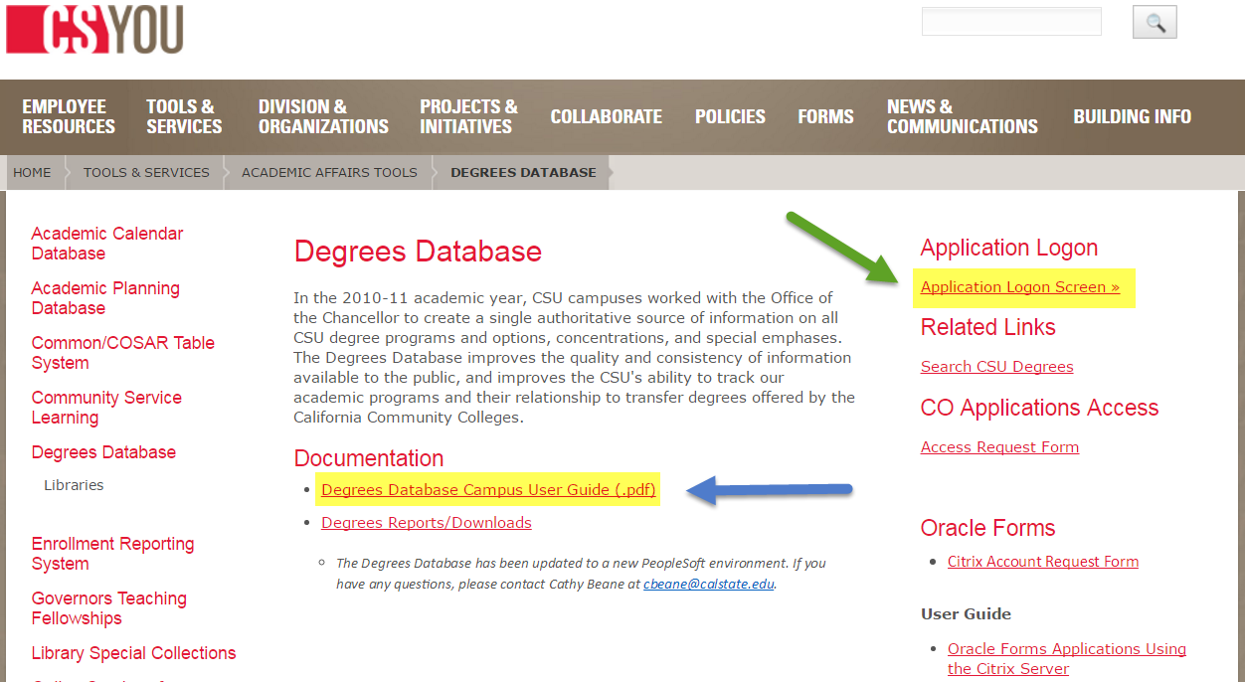
Accessing the Degrees Database
https://csyou.calstate.edu/Tools/academic-affairs/degrees-database/Pages/default.aspx
Notes:
The Degrees Database is accessed through CSYOU and includes single sign-on security so there is no username or login other than your usual campus login. Detailed procedures for the Degrees Database are provided in the Degrees Database User Guide which is available on this same page and noted with the blue arrow.

Slide 4
Degrees Database Main Page
Notes:
This main page is available to those designated as the campus user or editor for the Degrees Database. This is where you will add new degrees or update existing degrees: degree titles, minimum units, suspension, discontinuance. Detailed instructions are provided in the Degrees Database User Guide.

Slide 5
Main Page - Search
Notes:
Use any, all or none of the search criteria to access the data. Only your campus entries will appear in the Search Results.

Slide 6
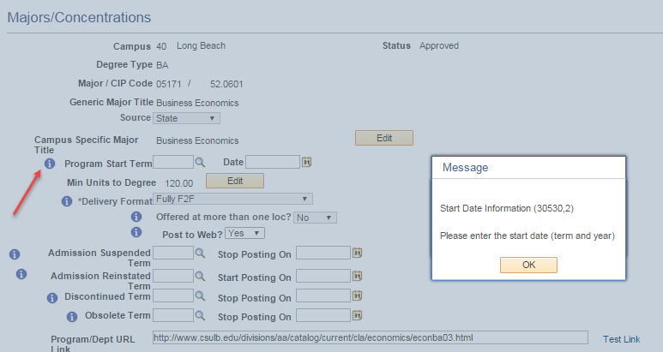
DDb Major Page
Includes information icons to define fields
Notes:
Descriptive information is included for most fields to provide clarification and details.

Slide 7
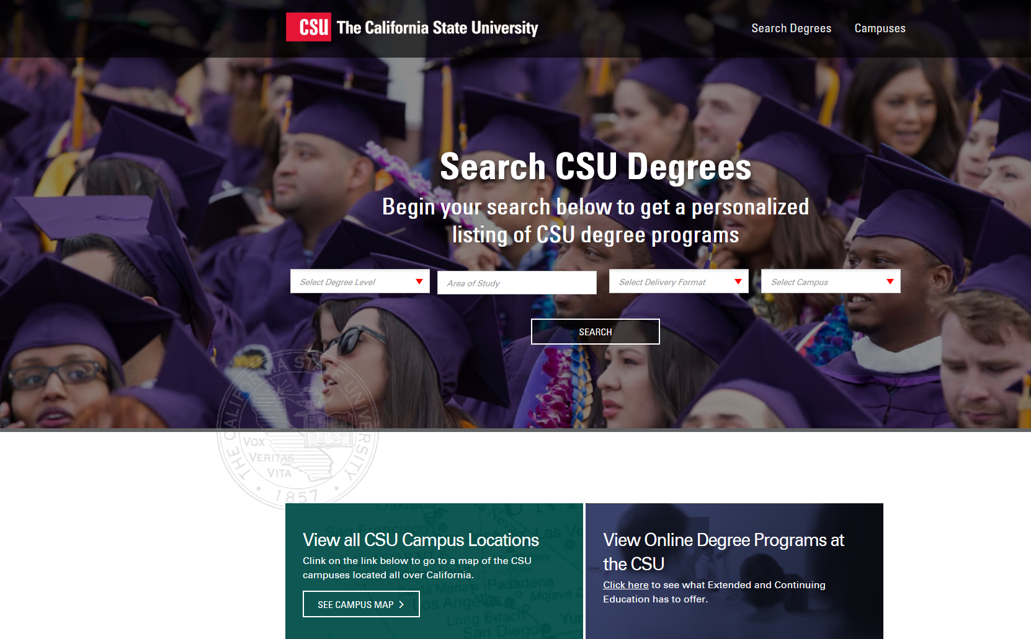
Search CSU Degrees Website
DDb feeds data to this search site
http://degrees.calstate.edu/
Notes:
This site is intended for prospective students and counselors as they search for degrees offered through the CSU. The degrees listed on this site are all active degrees in the DDb and coded “Yes” in the “Post to Web” field.

Slide 8
Search Degrees
Importance of proper degree titles, campus links, and videos
Provides information for prospective students
Consistency and maintenance of links:
Link to academic department webpage OR
Link to catalog degree requirements
Which has current and best information?
Broken links = lost opportunity
Notes:
The degree titles should match those that will appear on the student’s diploma; the links should be up-to-date; the videos must be closed-captioned.
The degree information should be clear to the student. The use of acronyms may be confusing to students.
Campuses usually link to either the academic department website or to the degree requirements as listed in the catalog. This is a campus decision and either is fine but the key is in the type and accuracy of information provided to the students.
Does the academic department webpage have old information? Is your catalog link to an archived catalog?
This is your chance to provide the best information for the prospective students using the site.

Slide 9
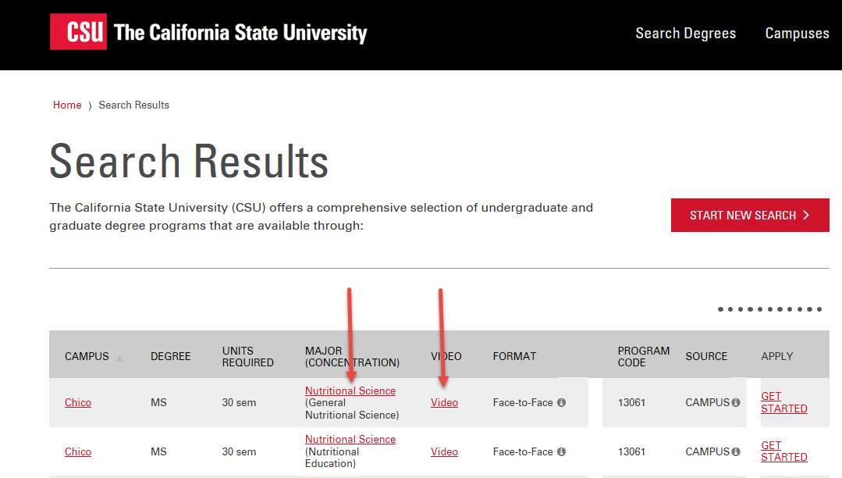
Search Degrees
Example of search entry with all updated links:
Notes:
Complete Degrees Database entries result in a search that includes a valid link to information about the program of interest along with a closed captioned video to introduce the student to the program and campus.

Slide 10
Campus Use of Reports-Degrees Database (DDb)
Available to all CSU faculty and staff via CSYou
Reports page is the landing page
Several standard reports offered
Custom Report for unique needs

Slide 11
Landing page–DDb Reports

Slide 12
DDb Reports
The reports page appears for both DDb users and guests
Defaulted to Current Programs Report
10 reports available
Most reports exclude inactive degrees
Admission Suspended
Discontinued
Obsolete
Notes:
Access to this page is available to all from the CSU system. Campus users who are designated for Degrees Database maintenance will also have access to other screens on the menu.

Slide 13
Two Most-Used Reports
Current Programs Report
Default report
Custom Report

Slide 14
Current Programs Report
Active programs only
Corresponds to majors published on Search CSU Degrees site http://degrees.calstate.edu/
Limited DDb data fields are listed in report

Slide 15
Current Program Report Access
Notes:
As mentioned, the Current Program Report is the default report on the landing page.

Slide 16
Current Program – Results Page
Notes:
Sample of results page.

Slide 17
Reports – Export to Excel
Scroll to the right to access the Excel icon
Click on the icon to create the spreadsheet

Slide 18
Custom Report
Active programs
Includes programs coded “No” in “Post to Web”
Includes “Other” in “Student Applies to” Field
Differs from other reports in that way
Complete list of active programs
Most DDb data fields are included on report
Notes:
The Custom Report would include more programs than the Current Report because there are no exclusions. The report also includes a larger number of data fields in the results.

Slide 19
Custom Report - Access
Notes:
Here is how the Custom Report is accessed.

Slide 20
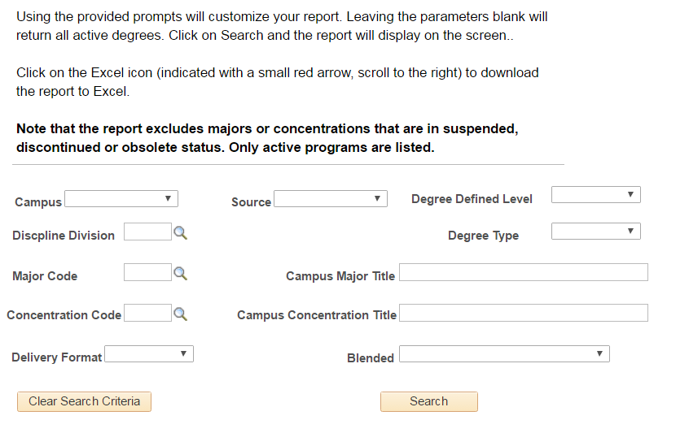
Custom Report – Criteria page
Expands the report criteria
Notes:
Once you click on Custom Report, the Criteria page appears. You may select any, all or no criteria for the report. Selecting no criteria will result in a report for all campuses and all degrees.

Slide 21
Custom Report Criteria
Standard search criteria, or
Search by key word in title
Search for blended programs
Search by delivery format
Face-to-face
Hybrid
Fully online
Notes:
These are criteria features not available on the standard reports.

Slide 22
Custom Report – Results Page
Notes:
Sample of results page. Scrolling to the right will provide access to the complete report with numerous data fields.

Slide 23
Custom Report – Export
Scroll to right to access Excel icon
Click on the icon to create spreadsheet
Most data fields are reported
Delete any unneeded data columns
Notes:
The report will be large, but any unnecessary columns may be deleted to create a customized report.

Slide 24
Additional Reports
Majors by Discipline
Concentrations by Discipline
Majors or Concentrations at 120/180 units
Majors or Concentrations over 120/180 units
These reports exclude inactive degrees
Notes:
These are the standard reports from the legacy system.

Slide 25
More Reports
Historical Programs Report
All entries to the DDb
Active + Inactive
Inactive Programs Report
Limited to inactive programs
Suspended, Discontinued, or Obsolete
Notes:
The Historical Programs Report includes everything entered into the Degrees Database.
The Inactive Programs Report should be helpful for determining if suspended programs should be updated: either to reactivate admission or move to discontinuance.
Discontinued is defined as teaching students out of a program no longer admitting new students.
Obsolete is used when there are no longer any students left in the discontinued program.

Slide 26
Helpful Hint
Reports page is home page
Click on “Home” from any Ddb screen
Upper right hand corner
Returns to Reports page
Refreshes page for Custom Report

Slide 27
Thank you for your help with the DDb!
Provides information for prospective students
Produces majors list for Cal State Apply
Helps with reporting and planning at the campus and systemwide levels
Creates a historical view of CSU Degrees
Notes:
With all you have to do, I like to take every opportunity to thank you for your efforts with the Degrees Database. I hope this information provides helpful tools available to you from the database.

Slide 28
Questions?

