Slide 1
Demystifying the AMP
Overview (created Fall 2021)

Slide 2
What is the AMP?
The Academic Master Plan (AMP) is a series of reports, prepared anew each year, that represent campus's current and projected degree programs along with program accreditation and campus WSCUC status.

Slide 3
Timelines
Mid fall: Annual AMP memo, and last year’s documents are sent to Campuses
First working Friday in January: Campuses submit their AMP materials
Mid-March: BOT reviews/approves the AMP submissions
After BOT approval, campuses may move forward with Full Degree Proposals for newly approved projected degrees

Slide 4
What do campuses submit?
A cover memo**
Ten-year Overview of Planned Programs*
Updates to the Campus Academic Plan*
Lists of suspended and discontinued programs**
Summary of WSCUC visits**
List of accredited academic units or programs*
Individual proposals for each New Projection**
*Submit last year's documents, sent to campuses in October, with updates made via track-changes.
**Newly prepared documents.

Slide 5
The Memo
Important

Slide 6
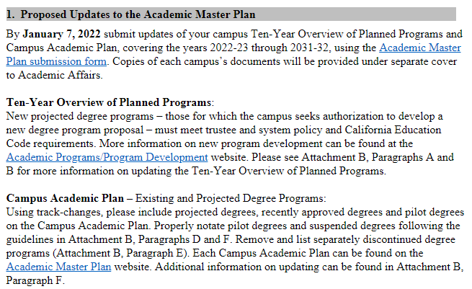
Updating and compiling the AMP
These are usually sent around the same time the memo is sent to campus presidents.

Slide 7
Updating the Ten-Year Overview of Planned Programs
Attachment B, Section A of the Memo

Slide 8
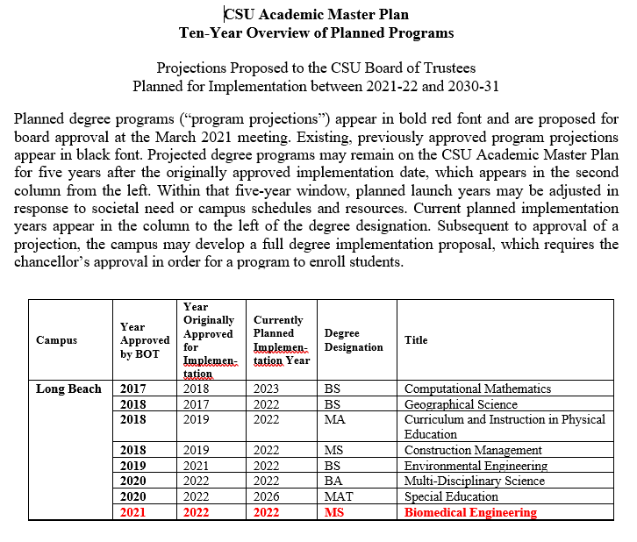
Example of a Ten-Year Overview of Planned Programs
Should say, "five years after the Year Approved by the BOT"

Slide 9
Projections and Timeframes
Attachment B, Section B

Slide 10
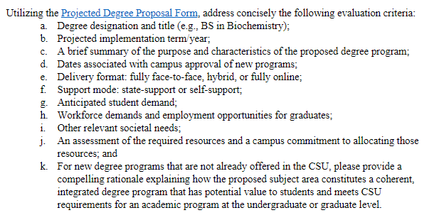
New Projection proposals should be submitted as individual files using the Projected Degree Proposal Form:

Slide 11
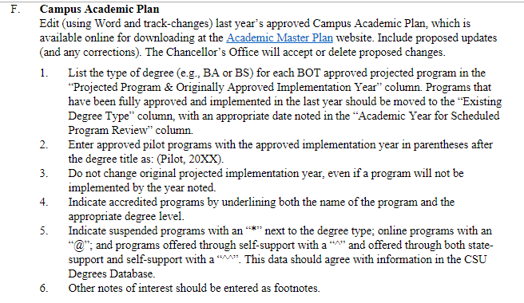
Updating the Campus Academic Plan
Attachment B, Section F of the Memo
Notice the symbols

Slide 12
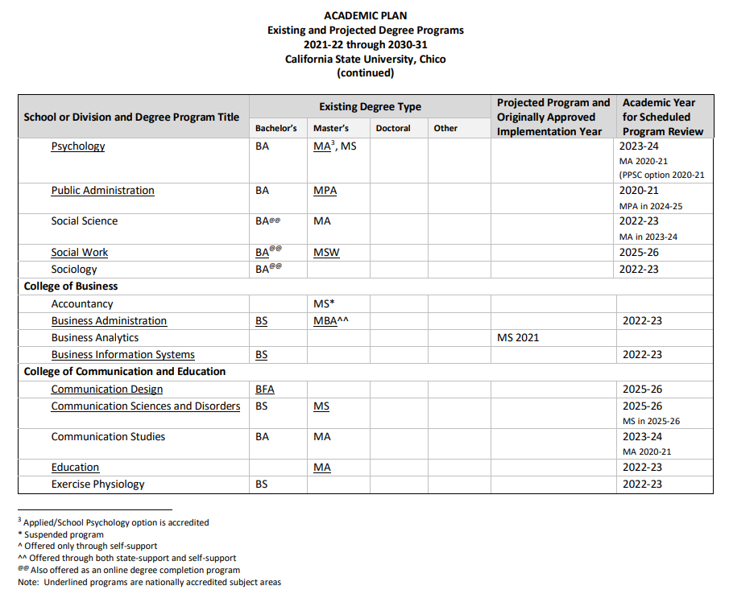
Example of a Campus Academic Plan

Slide 13
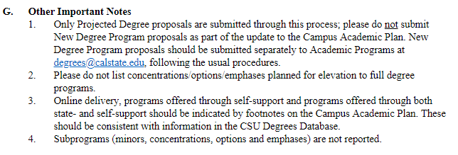
Additional Important Notes about Campus Academic Plan Reporting
Attachment B, Section G

Slide 14
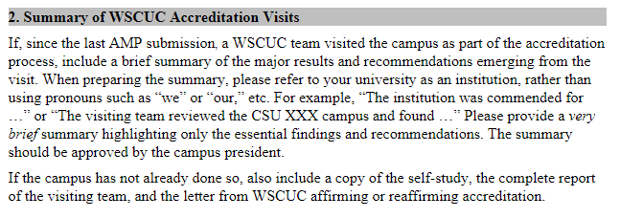
WSCUC Visits
This is only required for campuses that experienced a WSCUC visit since the last AMP cycle
If this applies to your campus, please include the WSCUC Commission letter.

Slide 15
Updating your Accredited Academic Units and Programs
Please carefully review the list for new degrees, discontinued degrees or lost/gained accreditation

Slide 16
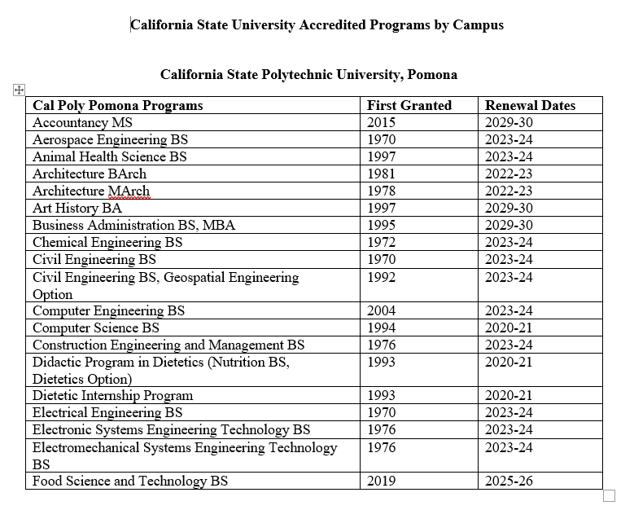
Example of Accredited Programs List

Slide 17
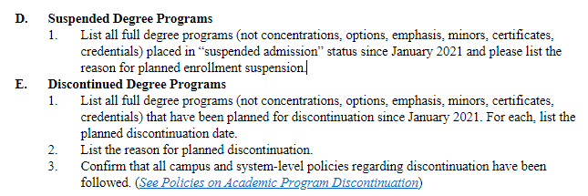
Provide lists of suspended and discontinued degree programs
And don't forget to update the Degrees Database.

Slide 18
CSU Degree Planning Process
Traditional & Fast-track
begin here
Pilot programs begin here
Campus Projects a new degree on the AMP
Trustee
Approval of Added Projection to AMP
Campus Develops Degree Proposal
Campus Revies/Approves Degree Proposal & Submits to CO
Students Enroll
Campus Action
Campus Authorized to Implement
Chancellor’s Office
Review and Approval
Notes:
The regular process begins with a degree projection—that is a plan to offer a degree program within the next ten years.
….and enroll students.
Pilot programs do no require board approval of a projection before the proposal can be developed.
Pilot programs can operate for five years before going to the board for permanent approval. Before a pilot can be implemented, the Chancellor’s Office has to confirm that the planned program complies with all applicable system policies.
[click]
Fast track projections can be brought to the board in twice a year—projections and the degree proposal can be submitted together in January (for Board action in March) and in July (for Board action in September).
The criteria for pilots and fast tracks are the same: (1) approved by the campus; (2) bachelor’s or master’s; (3) no major capital outlay is required; (4) not subject to accreditation; and (3) complies with all applicable laws and policies.

Slide 19
Pilot Programs
Make sure you meet the specified criteria
Two pilots allowed per campus
Follow through on procedures for approval beyond the authorized 5-year pilot period

Slide 20
Fast Track Proposal Process
Make sure you meet the specified criteria
Submit projection summary
Submit implementation proposal at the same time as a separate submission
Fast-Track Timeline
Two Deadlines:
1st Monday in January-for July approval
2nd Monday in June-for December approval

Slide 21
Thank you!
Contact us:
App@calstate.edu
Your Questions…

